Slide 1
Web Vibration analysis
101420

Slide 2
Test the time window

Slide 3
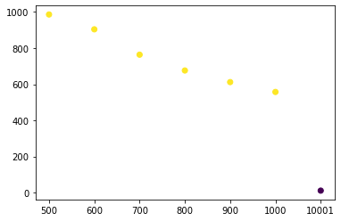
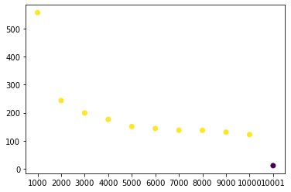

SNR in a smaller time window is larger
$$SNR= \frac{peak value}{variance without peak}$$
SNR
Window size
Window size

Slide 4
The last frame issue
Try the backward FFT

Slide 5
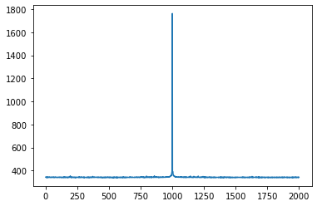
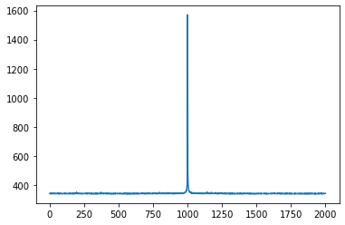
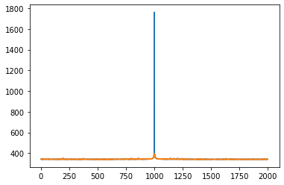
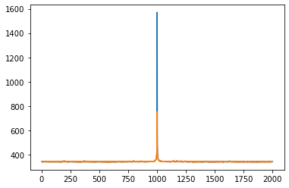
Last time problem: the original data
Short time FFT
T=0:10000
T=0:10001
dataFFT = np.abs(scipy.fft(data[res[0], res[1], :-1]))
dataFFT = np.abs(scipy.fft(data[res[0], res[1], :]))
So there’s a second peak round 300 Hz for the whole time series
This is why we got the results shown in the first part
But why does the last frame cause such a big difference?
Try 400 Hz to see whether it is also weird
200
400
200
400
FFT without removing the peak
FFT removing the peak
200
400
200
400

Slide 6
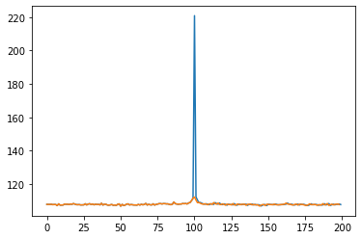
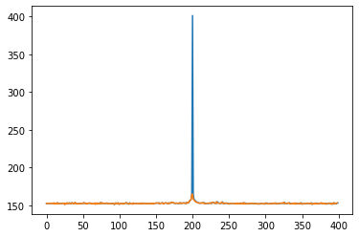
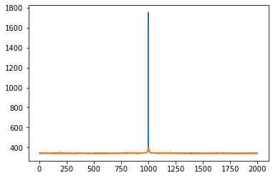

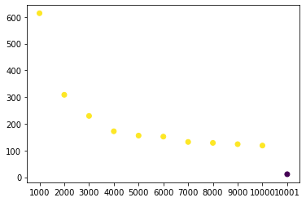

Backward FFT
Reverse the time series and perform the backward FFT
0 | 1 | 2 | … | 10001
10001 | 10000 | 9999 | … | 0
(The last frame is 10001 because I’ve removed the blank frame)
10001: 9001
10001: 8001
10001: 1
10001: 0
200
frequency
400
200
frequency
400
200
frequency
400
200
frequency
400
$$SNR= \frac{peak value}{variance without peak}$$
SNR
The problem is not in frame 1001
Window size

Slide 7
Sliding window FT

Slide 8
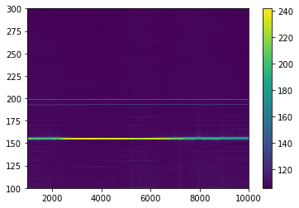
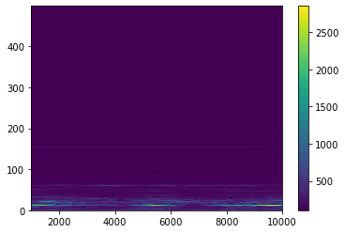
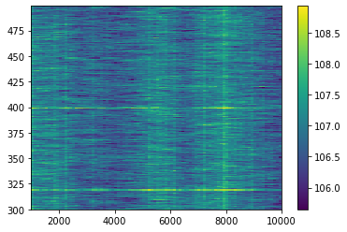
200 Hz (sliding window = 1000, step =100)
Frequency
Frames/time

Slide 9
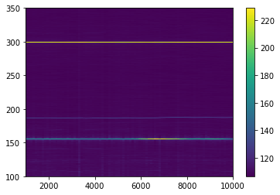
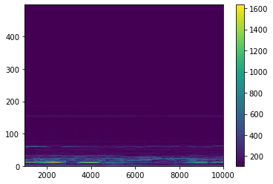
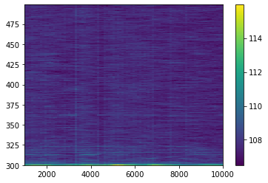
300 Hz (sliding window = 1000, step =100)
Frequency
Frames/time

Slide 10

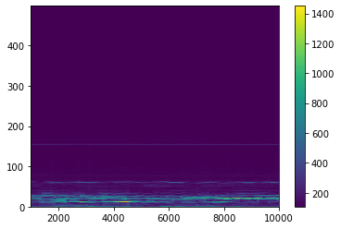
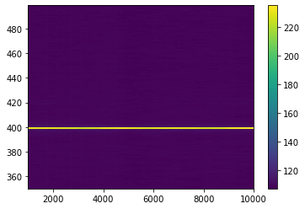
400 Hz (sliding window = 1000, step =100)
Frequency
Frames/time

Slide 11
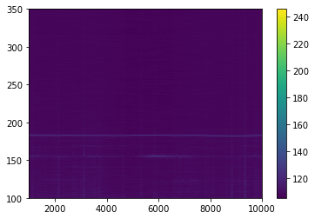
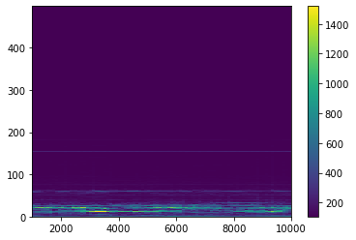
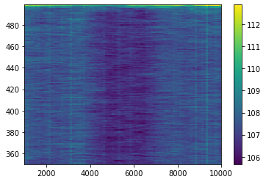
500 Hz (sliding window = 1000, step =100)

Slide 12
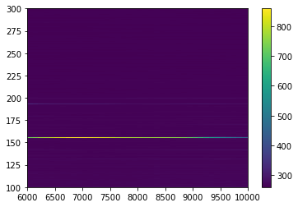
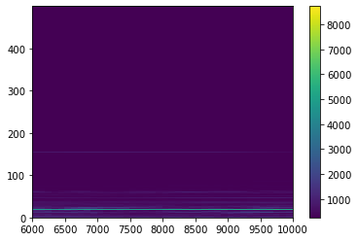
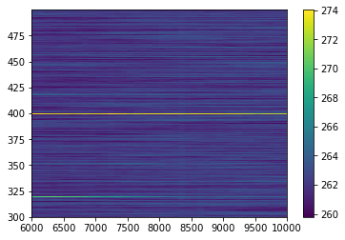
200 Hz (sliding window = 6000, step =100)
Frequency
Frames/time

Slide 13
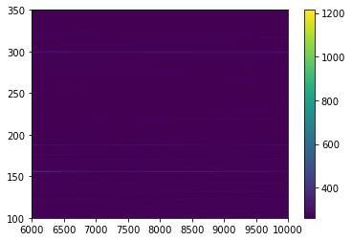
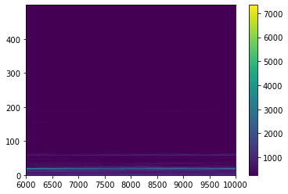
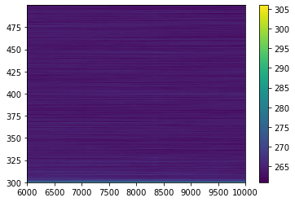
300 Hz (sliding window = 6000, step =100)
Frequency
Frames/time

Slide 14
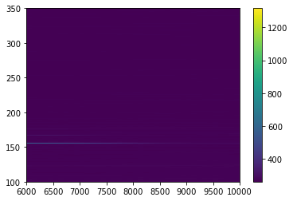

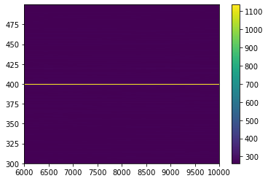
400 Hz (sliding window = 6000, step =100)
Frequency
Frames/time

Slide 15
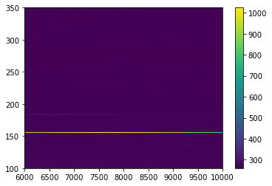
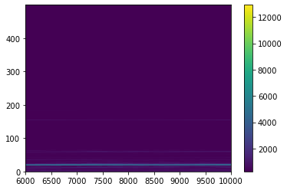
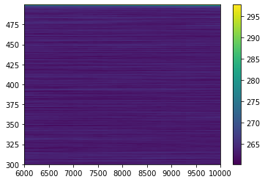
500 Hz (sliding window = 6000, step =100)
Frequency
Frames/time

Slide 16
Spatial FFT

Slide 17
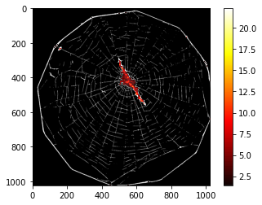
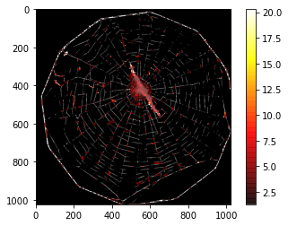
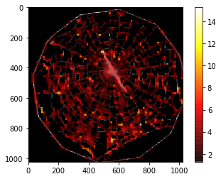
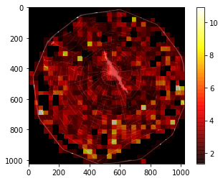




200 Hz (threshold =20)
4 $×$ 4 grid
8 $×$ 8 grid
16 $×$ 16 grid
32 $×$ 32 grid

Slide 18
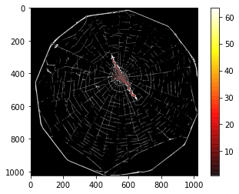
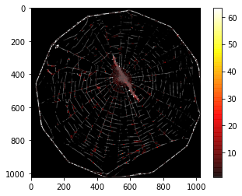
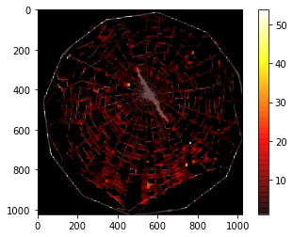
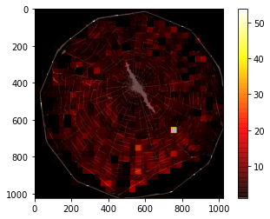
300 Hz (threshold =20)
4 $×$ 4 grid
8 $×$ 8 grid
16 $×$ 16 grid
32 $×$ 32 grid

Slide 19
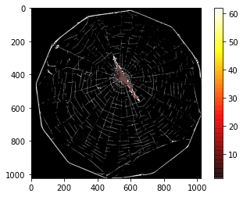
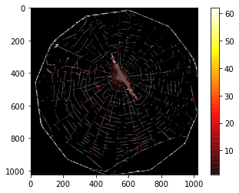
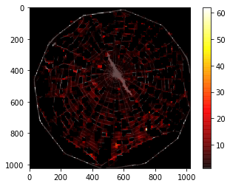
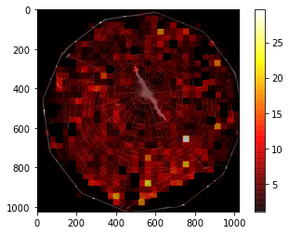

400 Hz (threshold =20)
4 $×$ 4 grid
8 $×$ 8 grid
16 $×$ 16 grid
32 $×$ 32 grid

Slide 20


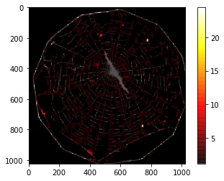
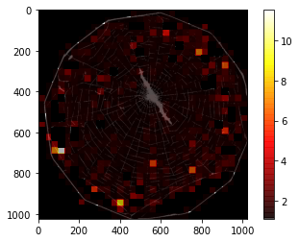
500 Hz (threshold =20)
4 $×$ 4 grid
8 $×$ 8 grid
16 $×$ 16 grid
32 $×$ 32 grid

